Slide 1

MQ SUMMIT 2026 · HAARLEM
When the Network Stops Behaving
Messaging lessons from autonomous systems at sea
Alex Kritikos
Co-founder & CEO, MAPS Messaging
mapsmessaging.io
Notes:
Good afternoon. I’m Alex Kritikos, co-founder and CEO of MAPS Messaging. I’ve spent much of my career working with messaging systems in financial markets, where reliability and latency are critical. Over the past year, we have been focusing on autonomous systems and as you may have guessed, we’ve been applying messaging technology.
Today I will be talking to you about how some assumptions we usually make about networks and message delivery don’t survive very well offshore.

Slide 2

05:40, SOMEWHERE OFFSHORE
An autonomous vessel drops from Starlink to narrowband SATCOM
283/s
NMEA 2000 frames one vessel keeps putting on its bus
15 s+
16 kbps
typical narrowband latency, against ~50 ms on Starlink
narrowband burst ceiling, and a cost per message
70/s
MAVLink frames another vessel keeps emitting
When the Network Stops Behaving · Alex Kritikos
mapsmessaging.io
Notes:
Imagine an autonomous surface vessel operating offshore. It’s connected over Starlink, sending telemetry back to shore. Due to a technical fault or entering an electronic warfare zone Starlink disappears, and the vessel switches to a narrowband satellite connection.
Suddenly, latency goes from milliseconds to potentially 15 seconds or more. Available bandwidth collapses to around 16 kilobits per second.
But the vessel doesn’t stop producing data.
If its based on NMEA 2000 CAN-bus it keeps generating 283 frames per second.
It is based on MAVLink it keeps generating 70 frames per second.
So what happens to all those messages?”
Pause briefly.

Slide 3

THEN THE LINK COMES BACK
Which of those messages were delivered?
Notes:
Eventually, the link comes back.
But here’s the interesting question.
Which messages were actually delivered?
And perhaps more importantly, which messages still matter?
Pause.
We’ll come back to that.

Slide 4
WHERE THE DATA COMES FROM
REPMUS: a four-week integration test, at sea
300
36
3,700+
4 weeks
uncrewed systems put through their paces
navies represented
participants, and 60 R&D companies
Tróia, Portugal, 31 Aug – 25 Sep 2026
Led by the Portuguese Navy with NATO’s maritime research centre (CMRE). Drones, boats and command systems from different nations and vendors have to work together, over links that fail.
Our part: a crewed vessel and three uncrewed surface vessels connected into the shared operational picture, taking tasks from two command systems.
mapsmessaging.io
Notes:
These aren’t hypothetical scenarios.
Last month, we spent four weeks at REPMUS in Portugal, one of the world’s largest maritime robotics exercises.
REPMUS stands for Robotic Experimentation and Prototyping with Maritime Unmanned Systems
Hundreds of autonomous systems, dozens of navies, thousands of participants.
Our responsibility was to connect three autonomous surface vessels and a crewed vessel into the shared operational picture, including bidirectional tasking from different command systems.
We collected all messaging data from the exercise and some measurements you’ll see today come from those systems.

Slide 5


01 · THE TERRAIN
Many sources, one edge, unreliable links
Starlink : drones, vessels offshore
Drones : MAVLink
MAPS Edge node
Shore
LTE : drones, near shore
Command Systems (Proprietary or NATO STANAG 4817)
Your Broker
Vessels : NMEA 2000
Mediates, buffers, decides what leaves
IoT Nano : narrowband L-band
Sensors : MQTT / CoAP
Nothing : for minutes to hours
Different protocols, schemas and guarantees on one side. A link you cannot trust on the other.
When the Network Stops Behaving · Alex Kritikos
Notes:
On the left, we have systems that speak completely different protocols.
Drones speak MAVLink.
Marine electronics speak NMEA 2000.
Sensors speak MQTT or CoAP
At the edge, we need to decode, normalise and route that information.
Then comes the difficult part.
We might have Starlink, LTE, narrowband satellite communications - or absolutely nothing.
And on the other side, we have command systems and brokers that still expect useful information.
<Pause>
The edge is where we have to make decisions about what information is worth sending.

Slide 6
01 · THE TERRAIN
Three orders of magnitude between links
Link | Used by | Typical latency | What it means
LTE | Drones, vessels near shore | ~35–50 ms median | Fast, until the coast is out of range
Starlink | Drones, vessels offshore | 41–144 ms median (Europe) | Broadband, with obstructions and handovers
Viasat IoT Nano (Orbcomm STx) | Fallback for vessels and buoys | <15 s small messages; 15–60 s | Messages, not streams: bursts up to 16 kbps
None | Everyone, sometimes | ∞ | Store, then decide
A design that only works at 50 ms will fail at 15 seconds.
Sources: Opensignal (LTE, Spain), Ookla Speedtest (mobile H2 2025; Starlink Europe Q4 2024), Viasat IoT Nano service
Notes:
Look at the difference between these links.
LTE and Starlink operate in milliseconds.
Narrowband satellite messaging operates in seconds.
And sometimes there’s no connectivity at all.
You cannot build a resilient messaging architecture assuming the network will always behave like Ethernet.
<Pause>
So the first thing we learned is that we have to change what we send.

Slide 7

02 · FROM BUS TO STATE
At the edge, the broker and the integration are one job
MAVLink
ONE MAPS EDGE NODE
MQTT
NMEA 2000 / CAN
Integration
Broker
AMQP 1.0
· Decode vehicle protocols
· Build the digital twin
· Transform, validate schemas
· Translate tasks both ways
· Topics and sessions
· Delivery guarantees per protocol
· Store and forward on disk
· Links that drain on reconnect
CoAP · MQTT-SN
NATS
STANAG 4817
Your shore broker
DDS
Split them into two nodes / processes and you add a second failure domain, and a link between them that also has to survive the outage.
When the Network Stops Behaving · Alex Kritikos
Notes:
Traditionally, we separate protocol integration and encoding transformation from the message broker.
One component decodes vehicle data. Another handles message encoding and persistence. Another handles routing over a potentially different protocol.
But on an autonomous vessel, every additional process, dependency or network connection introduces another potential failure point.
Our approach is to bring those capabilities together at the edge as a single node / process.
The same node understands the source protocol, maintains state, and controls message delivery.
<Pause>
Integration and delivery policy must cooperate closely at the edge.

Slide 8
02 · FROM BUS TO STATE
Speak the vehicle’s own protocol at the edge
Drones · MAVLink 2
Vessels · NMEA 2000
udp:// listener, ArduPilot dialect
canbus:// listener on the boat’s CAN bus
• One topic per message: /mavlink/{systemId}/{messageName}
• Frames of 12 bytes overhead plus a 0–255-byte payload
• Rejected frames go to a dead-letter topic, not the floor
• One topic per PGN: /can1/{pgn}/{name}
• 8-byte frames at 250 kbit/s; fast-packet messages up to 223 bytes
• On one vessel: 17 source addresses, 36 decoded PGNs, plus proprietary traffic
Decode once, at the source. Downstream, everything is a topic.
MAPS edge config (marine and GCS classes) · MAVLink 2 and NMEA 2000 framing
Notes:
Here’s a couple of specific examples.
We connect directly to MAVLink over UDP or NMEA 2000 over CAN bus.
Rather than forwarding opaque binary frames and expecting someone downstream to interpret them, we decode them at the source.
Each message becomes available through a topic.
That means the downstream messaging system no longer needs to understand the vehicle’s proprietary or specialised protocol.
<Pause>
Decode once, at the edge.

Slide 9
02 · FROM BUS TO STATE
One vessel, 283 frames a second
IoT Nano burst ceiling, 16 kbps
NMEA 2000 frames as JSON
~750 kbps
Same frames, raw binary
29 kbps
Twin state, 2 Hz
27 kbps
STANAG 4817 status, 1 Hz, JSON
11 kbps
Same status as protobuf
1.8 kbps
1
10
100
1,000 kbps
Raw, it does not fit. As state, it does.
REPMUS 2026 vessel: median of 4,552 live minutes; sizes from recorded payloads. Log scale.
Notes:
Here’s what we actually measured on one vessel.
Its NMEA 2000 bus was generating approximately 283 frames per second.
If we publish those frames as JSON, we’re looking at around 750 kilobits per second.
The narrowband satellite connection has a burst ceiling of 16 kilobits.
Clearly, that’s not going to work.
Sending raw binary is better, but still too much and kicks the decoding part later in the pipeline.
So instead, we build a representation of the vessel’s current state.
Then we generate a standardised operational status message.
And if we encode that message using protobuf, the required bandwidth drops to approximately 1.8 kilobits per second.
<Pause>
We haven’t just compressed the data. We’ve changed what we’re communicating.

Slide 10
02 · FROM BUS TO STATE
Frames become state, state becomes events
283 / s
2 / s
1 / s
1 / 15 s
NMEA 2000 frames
Twin
NODE_STATUS
NODE_DESCRIPTION
on the boat’s bus
/state/twins/RHIB-001
STANAG 4817
STANAG 4817
RATE
LIVENESS
VALIDITY
Twin every 500 ms, status every 1 s, description every 15 s
Heartbeat 5 s, stale after 10 s, twin retired after 120 s
Every status says how long it stays true: 2 hours at REPMUS
Every one of these is configuration, per asset class. None of it is code.
REPMUS 2026 vessel recorded cadences (median intervals) · MAPS TwinManager configuration
Notes:
Instead of forwarding 283 frames every second, we continuously update the vessel’s digital representation, not in another process but directly on the messaging namespace.
This can happen with various strategies like a sliding window or last value depending on the use case.
In this instance that state is published twice per second. However the operational status we route to shore is published once per second.
And less frequently changing information, such as the vessel description, is published every 15 seconds.
These are different kinds of information, with different requirements, per mission and per available link.
We also distinguish between whether an asset is alive, whether its information is stale, and how long that information remains valid.

Slide 11
02 · FROM BUS TO STATE
Down-sample before you route, not after
Path | What leaves the edge | Measured | Suits
Raw bus | Every NMEA 2000 frame, as JSON | ~750 kbps | Nothing off the boat
4817 High bandwidth | STANAG 4817 JSON, status at 1 Hz | 16.8 kbps | LTE, Starlink
4817 Medium bandwidth | The same messages as protobuf | ~2.7 kbps | Degraded or shared links
Narrowband | Protobuf status at a mission-set interval | [per mission] | IoT Nano (STx)
Per message, a 4817 status is 1,475 bytes as JSON and 226 as protobuf: 6.5× smaller
Per broker, using MQTT 5 topic alias saved 27MB of traffic / hour / asset
REPMUS 2026: vessel capture, both encodings recorded (protobuf feed estimated per message class)
Notes:
Now we can apply different delivery policies depending on the available link.
Over broadband, we can send more frequent updates in JSON.
Over constrained links, we can switch to protobuf.
If we route between intermediate MAPS instances, a pipeline that expects JSON at shore can still use protobuf until the last hop.
Over narrowband satellite, we reduce the update frequency further.
The important point is that these decisions happen before the data enters the expensive or unreliable link. And most of the time you may not know what link will be available until the mission starts.

Slide 12
02 · FROM BUS TO STATE
The whole pipeline is configuration
TwinManager:
heartbeatTimeoutMillis: 5000
staleTimeoutMillis: 10000
retentionTimeoutMillis: 120000
publish:
topicTemplate: /state/twins/{twinId}
publishRateMs: 500
n2k:
topic: /can1/#
stateAdapters:
stanag:
statusIntervalSec: 1
descriptionIntervalSec: 15
taskTopicTemplate:
4817/catl/maps/json/{twinId}/…
bridge: # JSON in, protobuf out
jsonNamespace: 4817/catl/maps/json
protobufNamespace: 4817/catl/maps/proto
MAPS edge, marine class, as run at REPMUS 2026 (trimmed; identities and hosts removed)
Notes:
These policies are just runtime configuration.
We can change publish frequency, state retention, protocol mappings and encoding without rewriting the application.
This is a shortened version of the configuration we used during REPMUS.

Slide 13
03 · TASKING GOES BOTH WAYS
One task, down and back up
DOWN
TASK_ADMIN: PATROL, SURVEY, NAVIGATE…
Persisted under /incoming
MAVLink mission upload
C2 systems
Shore MAPS
Edge MAPS
Autopilot
STANAG 4817 / TAK or proprietary
Routes tasks to the node
Twin and STANAG adapter
ArduPilot, MAVLink
TASK_FEEDBACK · NODE_STATUS · DYNAMIC_UPDATE · TASK_RESULT
Twin state
MAVLink telemetry
UP
Task feedback is the end-to-end ack: the edge reports what the vehicle is doing, not what a broker stored.
REPMUS 2026: MAPS C2 node configuration; vessel STANAG capture
Notes:
Until now, we’ve talked about telemetry flowing from the vessel to shore.
But autonomous systems also receive instructions.
A command system might tell a drone to survey an area.
That task passes through the messaging infrastructure, reaches the edge, and is translated into the vehicle’s native protocol.
But here’s the critical distinction.
The broker acknowledging receipt of the task does not mean the vehicle accepted it.
And acceptance doesn’t mean execution.
And execution doesn’t mean success.
We need feedback from the actual vehicle to know what happened.
<Pause>
Transport acknowledgement and operational acknowledgement are different things.

Slide 14
03 · TASKING GOES BOTH WAYS
REPMUS, 21 September: a partner C2 tasks our USV
14:40:47
+1.1 s
+4.2 s
every 2 s
14:53:51
SURVEY pushed
PENDING
ACTIVE
Progress
SUCCEEDED
by a partner C2: 8-point polygon
task accepted at the edge
mission running on the autopilot
393 feedback messages
13 minutes after the push
That afternoon: 14 tasks, 5 task types, 2 C2 systems. Median 181 ms from push to first feedback.
REPMUS 2026 STANAG 4817 capture
Notes:
Here’s an actual example from September 21.
A partner command system issued a survey task to one of our autonomous vessels.
Within just over a second, the task was accepted. The particular vessel could not calculate how to survey a polygon, so we created a MAVLink mission with waypoints driving how to traverse it.
A few seconds later, the autopilot was executing it.
Over the next 13 minutes, the system reported progress through hundreds of feedback messages.
Finally, the task completed successfully.
That afternoon, we handled 14 tasks across five task types and two different command systems.
The median time from task submission to first feedback was 181 milliseconds.
<Pause>
That’s what operationally meaningful end-to-end messaging looks like.

Slide 15
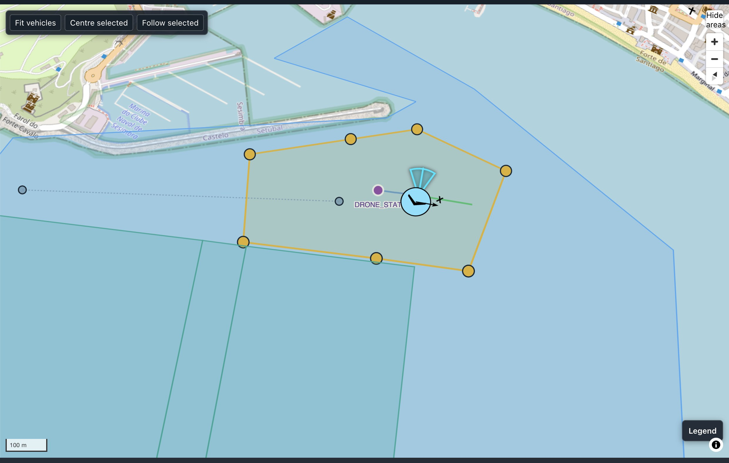
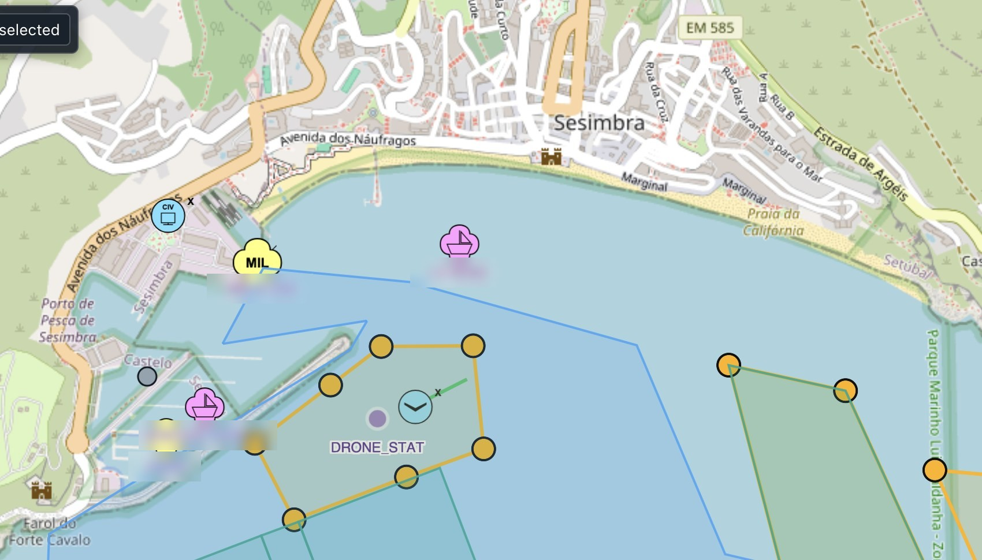
03 · TASKING GOES BOTH WAYS
One survey, two views
Vehicle view: the survey at 79.9%
Operational view: the same survey on the COP
REPMUS 2026 - map data © OpenStreetMap contributors
Notes:
On the left is the vehicle’s view of the survey.
On the right is the operational picture seen by the command system.
Different software, different interfaces, but the same mission and the same underlying state.
And no requirement for either system to understand the other’s internal implementation.

Slide 16
04 · DELIVERED IS INCOMPLETE
One message, five hops, four different acks
Sensor
Edge broker
Sat modem
Shore broker
Consumer
Published (QOS 1)
MQTT PUBACK: the edge has it.
STx ack: the message left.
AMQP settled: shore has it.
Processed? Nobody tells the sensor.
Each ack is true. None of them means the message did its job.
When the Network Stops Behaving · Alex Kritikos
Notes:
Let’s return to the question from the beginning.
What does delivered mean?
Imagine a sensor publishing a message using MQTT QoS 1.
The edge broker acknowledges it.
Then the message travels over a satellite connection, where another acknowledgement is generated.
Eventually, a shore broker receives it and acknowledges it using AMQP.
Every component along the way may report success.
But did the application actually process the message?
Did the command system act on it?
Did the operator ever see it?
The messaging infrastructure cannot necessarily answer those questions.
<Pause>
Successful transport does not imply successful operational processing

Slide 17
04 · DELIVERED IS INCOMPLETE
What an ack actually promises
Protocol | An ack means | It does not tell you
MQTT QoS 1 | Completion of an at-least-once delivery exchange | Whether it went any further
MQTT QoS 2 | Completion of an exactly-once delivery exchange | Anything past the broker
AMQP 1.0 | A delivery outcome accepted or settled by the peer | What the far end did with it
CoAP confirmable | Reliable receipt at the CoAP layer, not necessarily application completion | Whether it was processed
NMEA 2K / RAW UDP | No comparable end-to-end application acknowledgement | Anything
When the Network Stops Behaving · Alex Kritikos
Notes:
Different messaging protocols provide different guarantees.
MQTT QoS 1 provides at-least-once delivery within its protocol exchange.
MQTT QoS 2 provides exactly-once delivery semantics within its defined scope.
AMQP and CoAP have their own acknowledgement models.
But none of these automatically gives us an end-to-end operational guarantee across a heterogeneous chain.
That guarantee has to be implemented at the application level.

Slide 18

Every acknowledgement is local.
End-to-end is something you design.
mapsmessaging.io
Notes:
Every acknowledgement is local.
End-to-end is something you design.
<Pause>
And that means using application-level identifiers, correlating requests with results, and understanding what success actually means for the operation.

Slide 19
05 · SHAPING A THIN LINK
You cannot transform what you cannot read
End-to-end protection wants
Mediation wants
The payload untouched from sensor to consumer
To filter, down-sample and re-encode at the edge
Decide per data class: sign what must survive, keep routing metadata readable, transform only at trusted points.
When the Network Stops Behaving · Alex Kritikos
mapsmessaging.io
Notes:
There’s another architectural tension.
End-to-end encryption is designed to prevent intermediaries from inspecting or modifying payloads.
But if we want to filter, transform or down-sample messages at the edge, we need access to their contents.
So the answer isn’t simply to encrypt everything or expose everything.
We need to define trust boundaries.
Which data can be transformed?
Which fields need end-to-end integrity?
And where are we prepared to trust an intermediary?
<Pause>
Security and mediation policies must be designed together.

Slide 20
05 · SHAPING A THIN LINK
Classify before the link degrades
Class | Examples | On a degraded link
1 · Commands & safety | Tasks, collision alerts | Always first, never dropped
2 · Current state | Position, heading, task progress | Latest value only
3 · Telemetry | Sensor streams, CAN / MAVLink frames | Down-sampled, or kept on board
Traffic classes are a design decision. The broker should enforce them, not guess them.
When the Network Stops Behaving · Alex Kritikos
Notes:
When connectivity becomes constrained, not all messages have equal importance.
Commands and safety alerts need priority.
Current position and state should usually replace older versions.
Raw telemetry can be down-sampled or retained locally.
These classifications need to be established before connectivity deteriorates.
Otherwise, the messaging system is simply trying to push everything through an increasingly narrow pipe.
<Pause>
And that brings us to perhaps the most dangerous part of an outage: when the network comes back.

Slide 21
06 · OUTAGE AND RECONNECT
When the vessel went quiet, the edge knew when and where
14:08:47
14:11:00.033
14:11 → 14:13
14:13:13
Last detection
Last status
Silence
TASK_RESULT: LOST
track update from the USV
38.4243 N, 9.0818 W · 1.5 m/s · course 179°
progress still advancing, on the task clock
at 59.2% of the patrol
No warning
A known last position
Cause
Speed, course and attitude normal up to the last message
Position, speed and course to the second, for the recovery
What failed, as confirmed from the edge message store
REPMUS 2026, vessel PATROL task, 20 Sept · STANAG 4817 record kept at the edge · times UTC
Notes:
Here’s another example from REPMUS.
During a patrol mission, one of the vessels stopped reporting.
We had its last known position, speed and heading.
We also knew the progress of its assigned task.
Eventually, the system reported that the task had been lost.
The important lesson is that losing connectivity doesn’t have to mean losing operational context.
If the edge retains the right information, we can distinguish between what we know, what we last knew, and what has become uncertain.

Slide 22
06 · OUTAGE AND RECONNECT
What survives an outage, by design
Data | Kept at the edge in | On reconnect
NMEA 2000 and MAVLink frames | Memory: the last 10 | Gone, already summarised into state
Twin state | Memory: the last 50 | Latest value, published again
Tasks pushed to the node | Disk partitions | Still there; not lost with the link
STANAG 4817, JSON and protobuf | Disk, compressed; sized for a 90-day gap | Drained up the push link
At REPMUS, 5,272 vessel statuses reached the COP path over a minute late. The latest arrived after 15.5 hours, long past its 2-hour validity.
MAPS edge store map (DestinationManager), REPMUS 2026 · vessel local vs COP-path records
Notes:
Different kinds of information need different persistence policies.
We don’t need to preserve every raw sensor frame forever.
For current state, the latest value may be sufficient.
Tasks, however, must survive disconnection.
And some operational messages need durable storage and eventual delivery.
During REPMUS, we analysed the entire common operational picture and we found more than 5,000 vessel status messages that reached the operational picture over a minute late.
The oldest delay was over 15 hours.
But those messages had a validity period of two hours.
So delivering them successfully could actually be misleading.
<Pause>
A message can be delivered correctly and still be operationally wrong.

Slide 23
06 · OUTAGE AND RECONNECT
Reconnection is the most dangerous moment
Link down: the backlog grows at the edge
Link back: everything at once
What downstream can absorb
Normal traffic
Time →
When the Network Stops Behaving · Alex Kritikos
Notes:
Most messaging systems focus heavily on what happens when a connection fails.
But what happens when it comes back?
Imagine a vessel that has been disconnected for several hours.
During that time, it has accumulated a substantial backlog.
When the connection returns, the system attempts to deliver everything.
Suddenly, we’re pushing historical traffic alongside current operational information.
We can overwhelm the link, overload consumers, and delay the very information operators need most.
It is quite possible that the operator will never see the live picture again, unless they manually discard the backlog.
<Point to the slide>
The problem isn’t just surviving the outage. It’s surviving the recovery.

Slide 24
06 · OUTAGE AND RECONNECT
Six ways to replay without flooding
Rate-limited replay
Priority lanes
Latest-value collapse
Drain at a fixed share of link and downstream capacity
Commands and state jump the backlog
Keep only the newest state per key
Expiry
Idempotent consumers
Consumer-set pace
Drop what is no longer true: STANAG validity, message TTLs
Duplicates are certain; make them harmless
MQTT 5 receive maximum, AMQP link credit
When the Network Stops Behaving · Alex Kritikos
Notes:
First, control the rate of replay.
Don’t allow the backlog to consume all available bandwidth or overwhelm downstream consumers.
Second, prioritise information.
Commands and current state should take precedence over historical telemetry.
Third, manage the semantics.
Expire information that is no longer valid.
Make consumers idempotent so duplicates don’t cause unintended actions.
And respect the receiving system’s flow-control mechanisms.
MQTT 5 and AMQP already provide useful mechanisms here, but the overall policy has to be designed.

Slide 25
06 · OUTAGE AND RECONNECT
A reconnect, in order
1
2
3
4
5
Restore the session and authenticate
Commands and alerts first
Latest state, collapsed per key
Backfill telemetry at a bounded rate
Expire the stale, and record what was dropped
Shore sees the present first and the past later, never the other way round.
When the Network Stops Behaving · Alex Kritikos
Notes:
Lets look at the desired reconnect sequence.
First, restore and authenticate the session.
Then deliver critical commands and alerts.
Next, publish the latest current state.
Only then begin replaying historical information at a controlled rate, excluding information that has expired.
The receiving system should see the present first and the past afterwards.
<Pause>
Recovery order is part of the application’s correctness model.

Slide 26

FROM REPMUS 2026
What we measured
6.5×
283 → 1
181 ms
smaller as protobuf: a STANAG 4817 status went from 1,475 to 226 bytes
NMEA 2000 frames per second, turned into one STANAG status at the edge
median from a task being pushed to the first feedback, across 14 tasks
REPMUS 2026: Vessel NMEA 2000 capture, Drone STANAG capture
mapsmessaging.io
Notes:
Let me leave you with three numbers from REPMUS.
First, using protobuf can reduce a standardised status message by a factor of 6.5
Second, we transformed 283 raw sensor frames per second into one operational status message per second
And third, we measured a median of 181 milliseconds from task submission to first feedback.
These demonstrate three things: bandwidth efficiency, meaningful state representation, and end-to-end operational feedback

Slide 27

07 · TAKE-HOME
Patterns for graceful degradation
1
Turn frames into state at the edge
4
Classify traffic before the link degrades
2
Down-sample per link, before routing
5
Persist state, not streams
3
Define “delivered” end to end: task feedback, not broker acks
6
Replay in priority order, and expire the stale
Notes:
If there’s one thing I’d like you to take away, it’s that resilient messaging isn’t just about choosing a reliable protocol or broker.
It’s about understanding the meaning and lifetime of the information you’re transporting.
It’s about deciding what matters when bandwidth disappears.
And it’s about designing what happens when connectivity returns.
Those principles apply just as much to industrial IoT, remote infrastructure and distributed applications as they do to autonomous vessels.

Slide 28


Design for the network you will actually have.
Alex Kritikos · MAPS Messaging
mapsmessaging.io · NATO DIANA 2026 cohort
info@mapsmessaging.io
Bringing drones, vessels or sensors onto your broker? That is what we do.
Notes:
We tend to design systems around the network we expect.
But operational systems have to survive the network we actually get.
And sometimes, that means no network at all.
Thank you.

Slide 29

Questions?
#MQsummit
Notes:
Likely questions, based on last year's room: How do you map MQTT QoS 2 onto AMQP across a bridge? What happens to persistent MQTT sessions when they expire during a long outage? How is security handled when the edge transforms messages? Have short answers ready for each.

